Slide 1

Unsupervised ML Project
Defining different segments of
wholesale distributor customers
Robin Falconer
Sep 2021

Slide 2





Background & Identified customer segments
Grocery store
Dataset: Clients of a wholesale distributor.
440 clients
Annual spending on diverse product categories:
Fresh, Milk, Grocery, Frozen, Detergents & Paper, Delicatessen
Data comes from Portugal with channels:
Retail, HoReCa (Hotel, Restaurant, Café)
Convenience store
Restaurant wholeseller
Supermarket (small)
Supermarket (big)

Slide 3
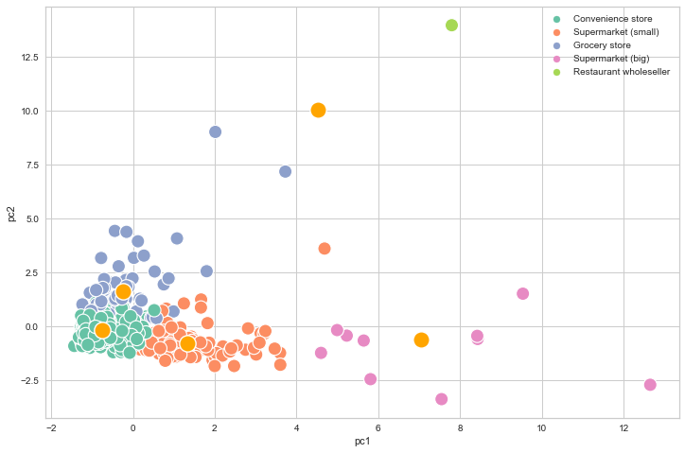
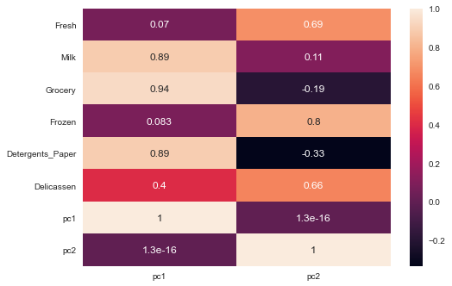
Initial analysis
Correlation matrix
→ PCA(2) = 73% variance explained
→ 5 clusters identified
PC_1 → “Milk”, “Grocery”, “Detergents & Paper”
PC_2 → “Fresh”, “Frozen”, “Delicatessen”

Slide 4
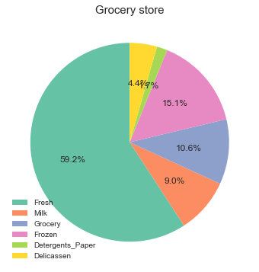
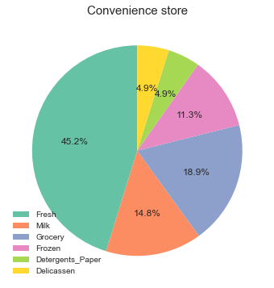
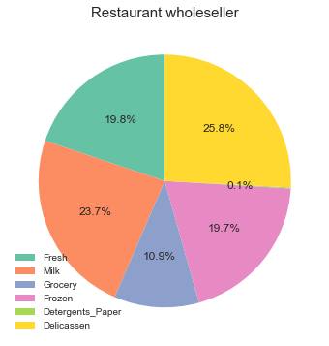
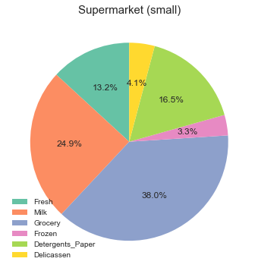
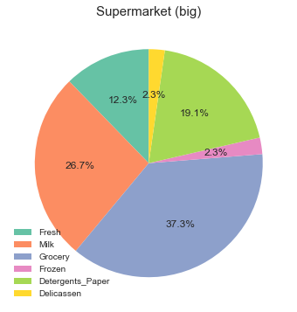
Total annual spendings per customer segment
5.4 M
3.5 M
0.9 M
1.3 M
4.2 M

Slide 5
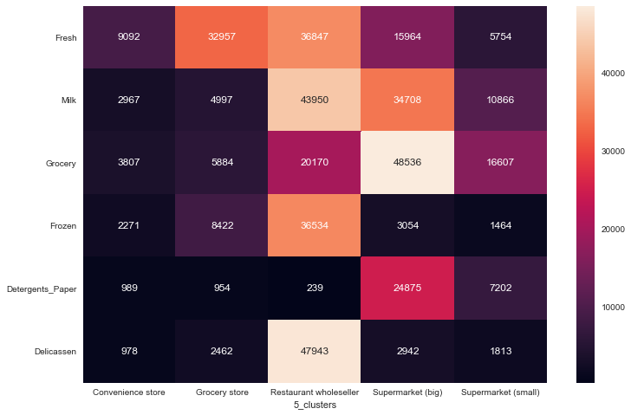
Average annual spendings per customer segment
Only supermarkets that spends on “Detergents & Paper”
Restaurant wholesellers spends on all product categories except on “Detergents & Paper”
Convenience stores spends on all product categories, however small amounts
Grocery stores spends most of their moneys on “Fresh products”

Slide 6
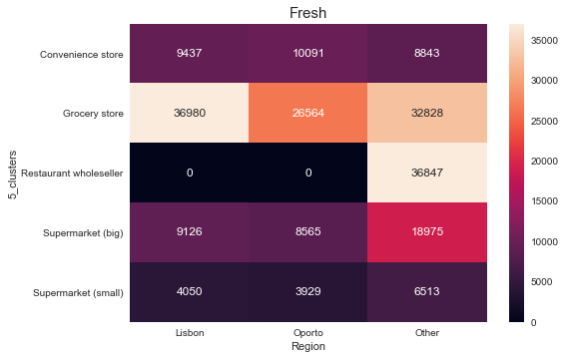
Average annual spendings per customer segment (Region)
Restaurant wholeseller located not in Lisbon or Oporto
Average spending on “Fresh products” similar in Lisbon and Oporto for all product categories except for Grocery stores
Large supermarkets spends on average more money on “Fresh products” in other locations than Lisbon and Oporto

Slide 7
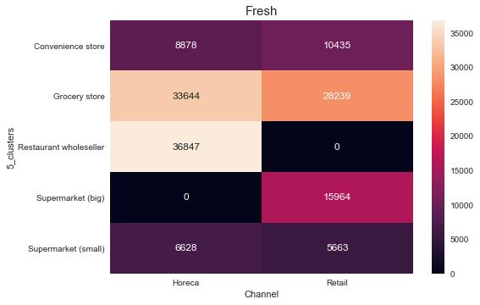
Average annual spendings per customer segment (Channels)
Restaurant wholeseller comes from HoReCa channels
Large supermarkets spendings only from retail customers
HoReCa customers uses different stores to buy their products

